Slide 1
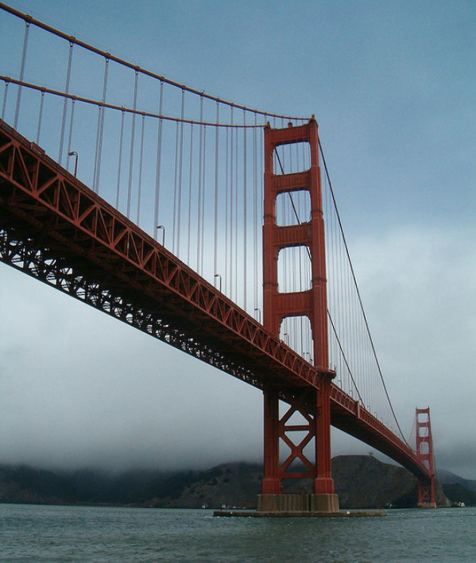
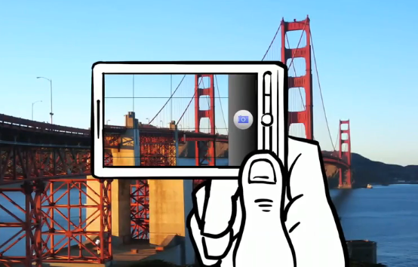
Lecture 5: Feature descriptors and matching
CS5670: Computer Vision
Noah Snavely

Slide 2
Reading
Szeliski: 4.1

Slide 3
Announcements
Project 2 is now released, due Monday, March 4, at 11:59pm
To be done in groups of 2
Please create a group on CMS once you have found a partner
Project 1 artifact voting will be underway soon
Quiz 1 is graded and available on Gradescope

Slide 4
Project 2 Demo

Slide 5

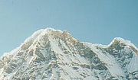
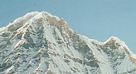
Local features: main components
Detection: Identify the interest points
Description: Extract vector feature descriptor surrounding each interest point.
Matching: Determine correspondence between descriptors in two views
Kristen Grauman

Slide 6

Feature descriptors
We know how to detect good points
Next question: How to match them?
Answer: Come up with a descriptor for each point, find similar descriptors between the two images
?

Slide 7
Feature descriptors
We know how to detect good points
Next question: How to match them?
Lots of possibilities
Simple option: match square windows around the point
State of the art approach: SIFT
David Lowe, UBC http://www.cs.ubc.ca/~lowe/keypoints/
?

Slide 8
Invariance vs. discriminability
Invariance:
Descriptor shouldn’t change even if image is transformed
Discriminability:
Descriptor should be highly unique for each point

Slide 9
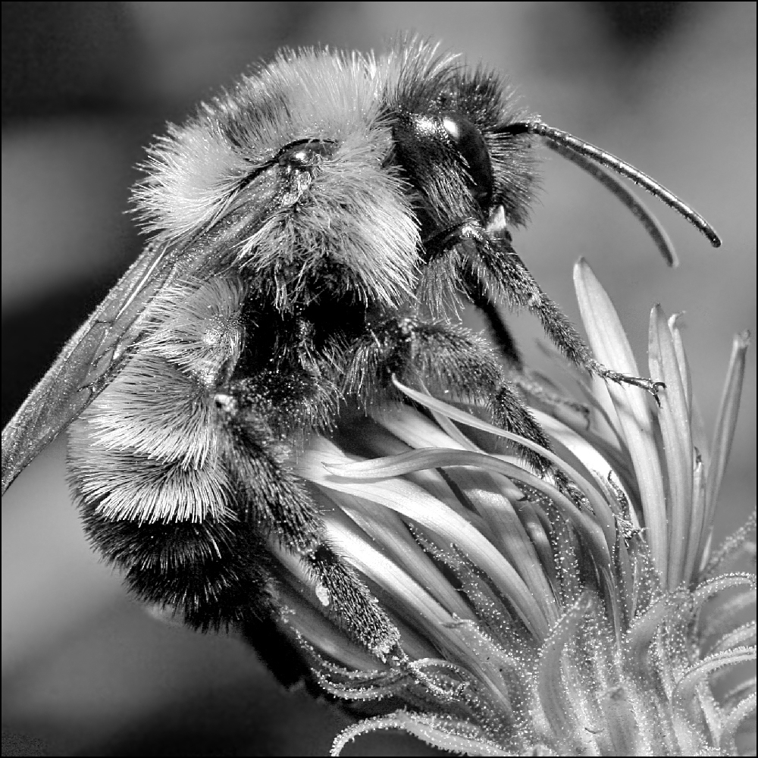
Image transformations revisited
Geometric
Rotation
Scale
Photometric
Intensity change

Slide 10
Invariance
Suppose we are comparing two images I₁ and I₂
I₂ may be a transformed version of I₁
What kinds of transformations are we likely to encounter in practice?

Slide 11
Invariant descriptors
We looked at invariant / equivariant detectors
Most feature descriptors are also designed to be invariant to
Translation, 2D rotation, scale
They can usually also handle
Limited 3D rotations (SIFT works up to about 60 degrees)
Limited affine transforms (some are fully affine invariant)
Limited illumination/contrast changes

Slide 12
How to achieve invariance
Need both of the following:
Make sure your detector is invariant
2. Design an invariant feature descriptor
Simplest descriptor: a single 0
What’s this invariant to?
Next simplest descriptor: a square, axis-aligned 5x5 window of pixels
What’s this invariant to?
Let’s look at some better approaches…

Slide 13
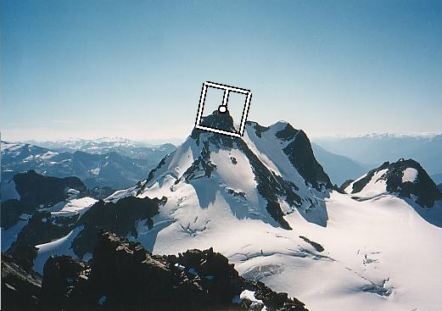
Rotation invariance for feature descriptors
Find dominant orientation of the image patch
E.g., given by x_{max}, the eigenvector of H corresponding to λ_{max} (the larger eigenvalue)
Or simply the orientation of the (smoothed) gradient
Rotate the patch according to this angle
Figure by Matthew Brown

Slide 14
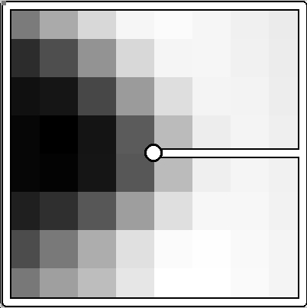
Multiscale Oriented PatcheS descriptor
Take 40x40 square window around detected feature
Scale to 1/5 size (using prefiltering)
Rotate to horizontal
Sample 8x8 square window centered at feature
Intensity normalize the window by subtracting the mean, dividing by the standard deviation in the window (why?)
40 pixels
8 pixels
Adapted from slide by Matthew Brown

Slide 15
Detections at multiple scales

Slide 16

Scale Invariant Feature Transform
Basic idea:
Take 16x16 square window around detected feature
Compute edge orientation (angle of the gradient - 90°) for each pixel
Throw out weak edges (threshold gradient magnitude)
Create histogram of surviving edge orientations
0
2π
angle histogram
Adapted from slide by David Lowe

Slide 17
SIFT descriptor
Full version
Divide the 16x16 window into a 4x4 grid of cells (2x2 case shown below)
Compute an orientation histogram for each cell
16 cells * 8 orientations = 128 dimensional descriptor
Adapted from slide by David Lowe

Slide 18
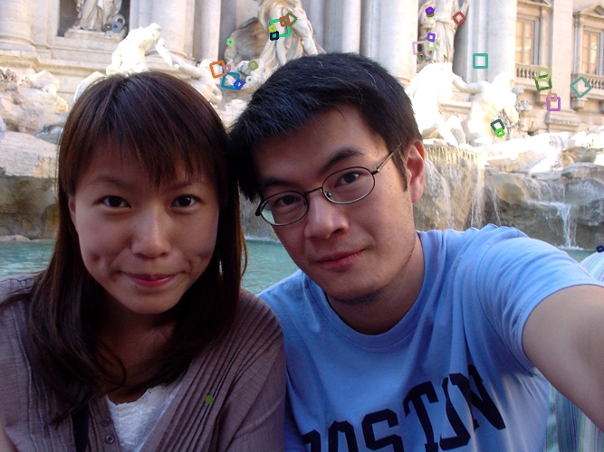
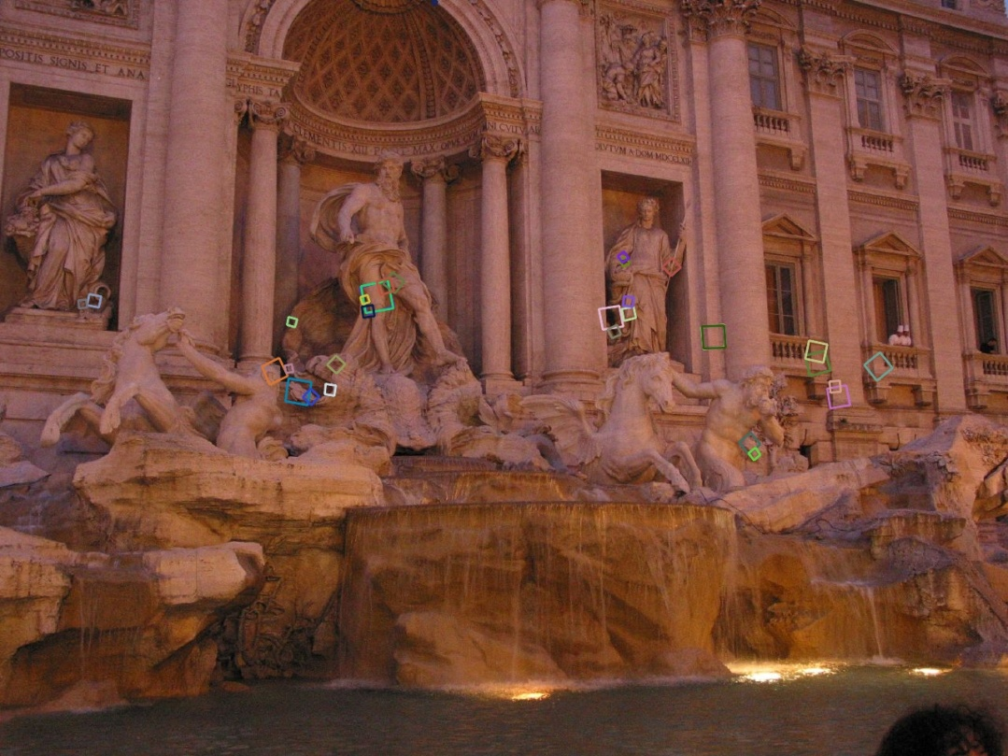
Properties of SIFT
Extraordinarily robust matching technique
Can handle changes in viewpoint
Up to about 60 degree out of plane rotation
Can handle significant changes in illumination
Sometimes even day vs. night (below)
Fast and efficient—can run in real time
Lots of code available
http://people.csail.mit.edu/albert/ladypack/wiki/index.php/Known_implementations_of_SIFT

Slide 19
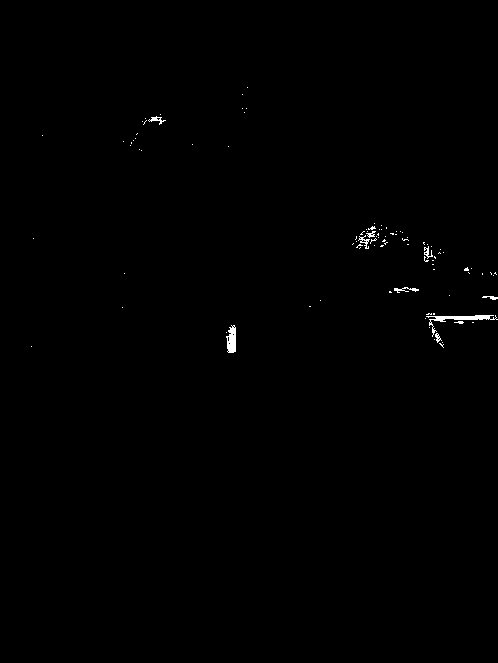
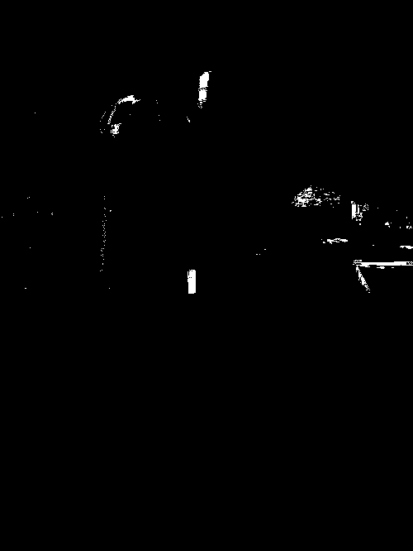
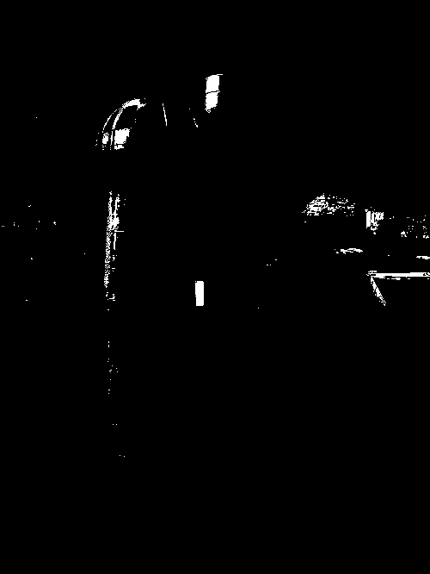
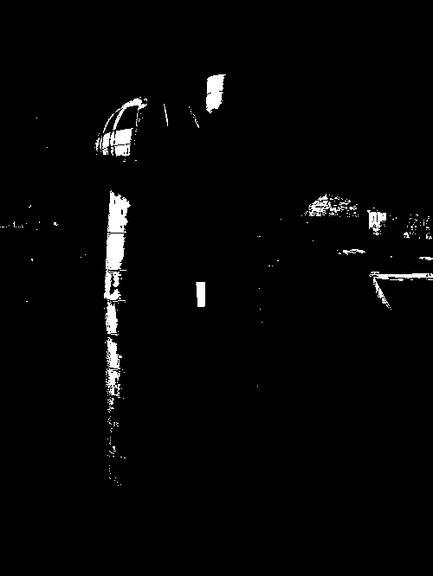
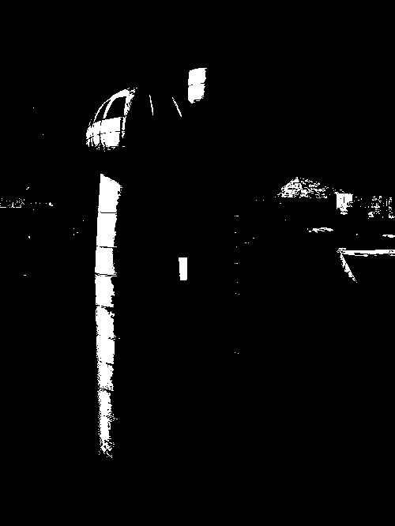
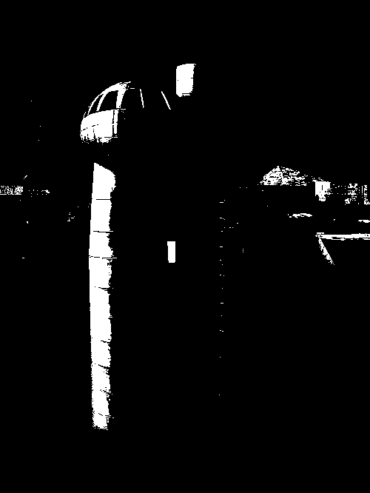
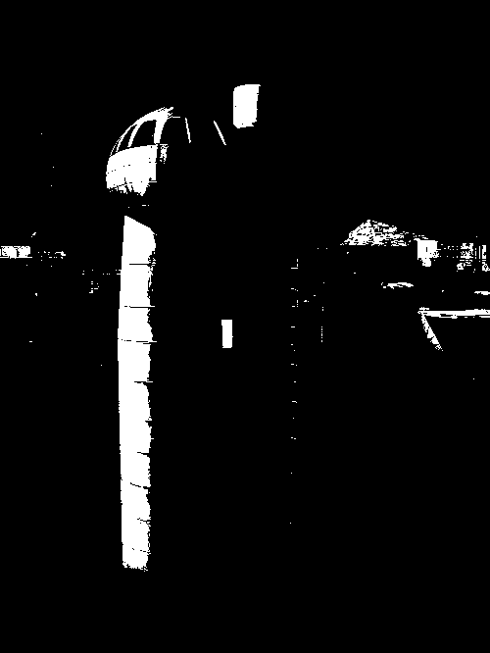



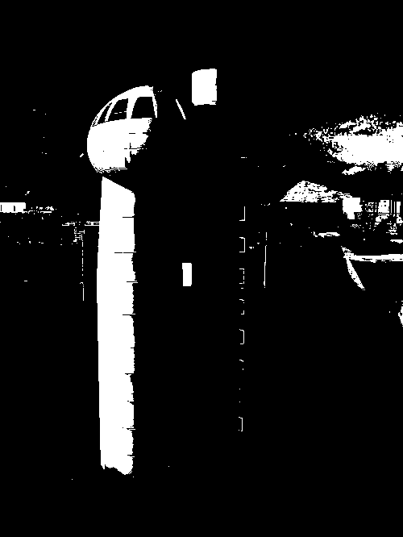
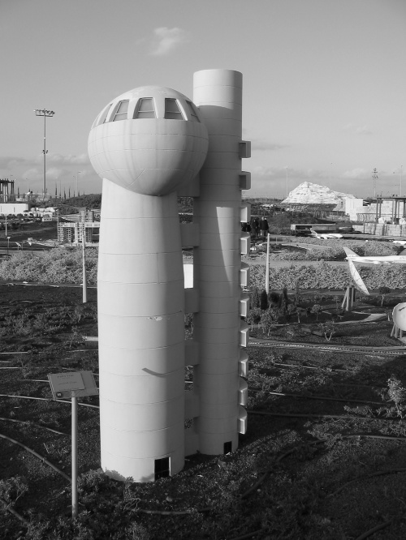
Maximally Stable Extremal Regions
J.Matas et.al. “Distinguished Regions for Wide-baseline Stereo”. BMVC 2002.
Maximally Stable Extremal Regions
Threshold image intensities: I > thresh for several increasing values of thresh
Extract connected components (“Extremal Regions”)
Find a threshold when region is “Maximally Stable”, i.e. local minimum of the relative growth
Approximate each region with an ellipse

Slide 20

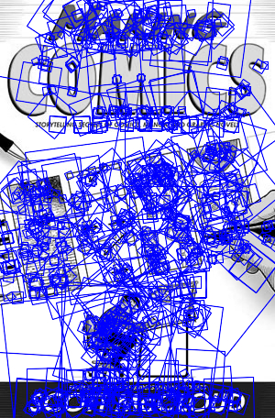
SIFT Example
sift
868 SIFT features

Slide 21
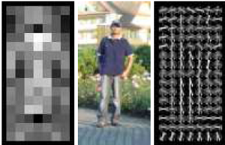
Other descriptors
HOG: Histogram of Gradients (HOG)
Dalal/Triggs
Sliding window, pedestrian detection
FREAK: Fast Retina Keypoint
Perceptually motivated
Used in Visual SLAM
LIFT: Learned Invariant Feature Transform
Learned via deep learning
https://arxiv.org/abs/1603.09114
Notes:
http://infoscience.epfl.ch/record/175537/files/2069.pdf
FREAK: Fast Retina Keypoint
The Binary Robust Independent Ele- mentary Feature (BRIEF) [5], the Oriented Fast and Ro- tated BRIEF (ORB)[26], and the Binary Robust Invariant Scalable Keypoints[16] (BRISK) are good examples.

Slide 22
Questions?

Slide 23
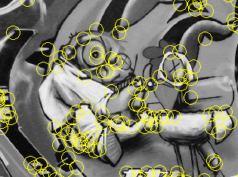
Summary
Keypoint detection: repeatable and distinctive
Corners, blobs, stable regions
Harris, DoG
Descriptors: robust and selective
spatial histograms of orientation
SIFT and variants are typically good for stitching and recognition
But, need not stick to one

Slide 24
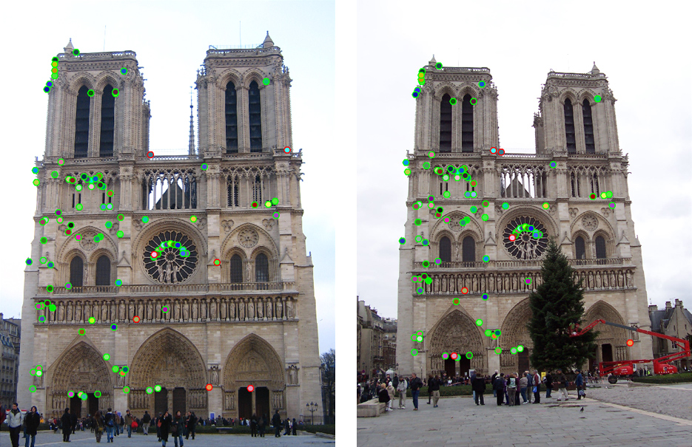
Which features match?

Slide 25
Feature matching
Given a feature in I₁, how to find the best match in I₂?
Define distance function that compares two descriptors
Test all the features in I₂, find the one with min distance

Slide 26
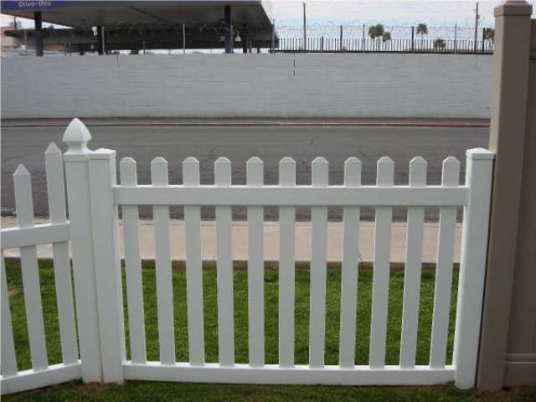
Feature distance
How to define the difference between two features f₁, f₂?
Simple approach: L₂ distance, ||f₁ - f₂ ||
can give small distances for ambiguous (incorrect) matches
f₁
f₂
I₁
I₂

Slide 27
Feature distance
How to define the difference between two features f₁, f₂?
Better approach: ratio distance = ||f₁ - f₂ || / || f₁ - f₂’ ||
f₂ is best SSD match to f₁ in I₂
f₂’ is 2nd best SSD match to f₁ in I₂
gives large values for ambiguous matches
f₁
f₂'
f₂
I₁
I₂

Slide 28
Feature distance
Does the SSD vs “ratio distance” change the best match to a given feature in image 1?

Slide 29
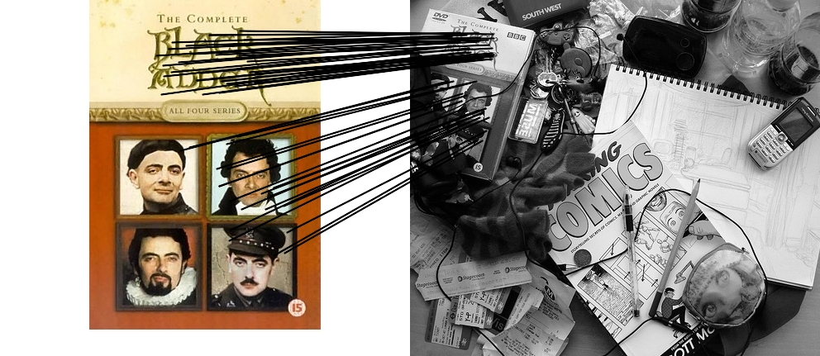


Feature matching example
58 matches (thresholded by ratio score)

Slide 30
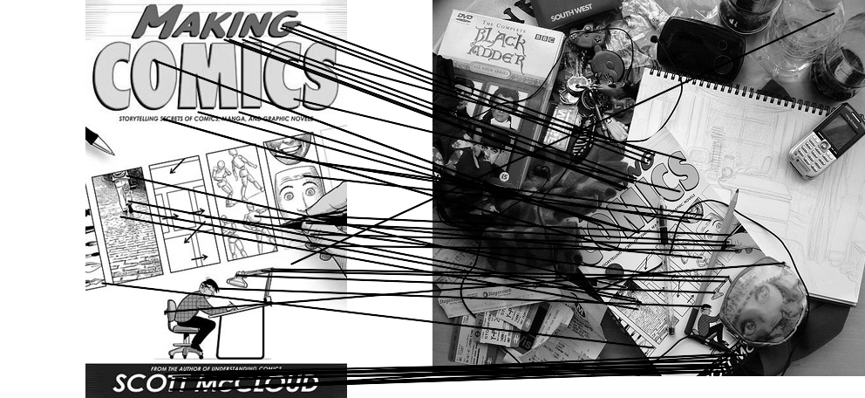

Feature matching example
We’ll deal with outliers later
51 matches (thresholded by ratio score)

Slide 31
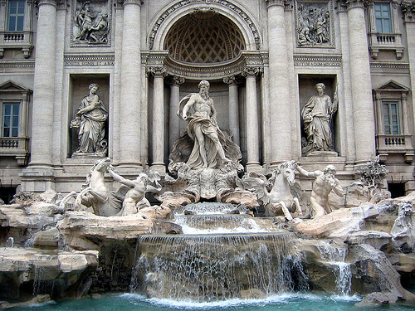
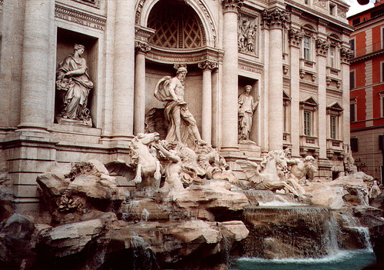
Evaluating the results
How can we measure the performance of a feature matcher?
50
75
200
feature distance

Slide 32
True/false positives
How can we measure the performance of a feature matcher?
The distance threshold affects performance
True positives = # of detected matches that are correct
Suppose we want to maximize these—how to choose threshold?
False positives = # of detected matches that are incorrect
Suppose we want to minimize these—how to choose threshold?
50
true match
75
200
false match
feature distance

Slide 33
Evaluating the results
How can we measure the performance of a feature matcher?
1
0.7
# true positives
# matching features (positives)
true positive rate
recall
0
1
false positive rate
0.1
# false positives
# unmatched features (negatives)
1 - specificity

Slide 34
Evaluating the results
How can we measure the performance of a feature matcher?
ROC curve (“Receiver Operator Characteristic”)
1
0.7
Single number: Area Under the Curve (AUC)
E.g. AUC = 0.87
1 is the best
# true positives
# matching features (positives)
true positive rate
recall
0
1
false positive rate
0.1
# false positives
# unmatched features (negatives)
1 - specificity

Slide 35
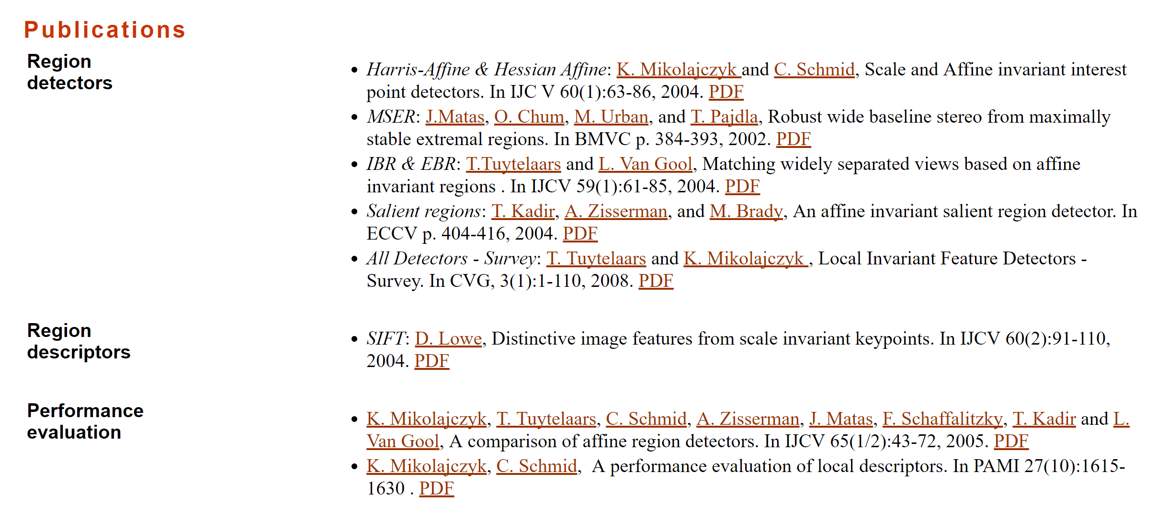
More on feature detection/description
http://www.robots.ox.ac.uk/~vgg/research/affine/
http://www.cs.ubc.ca/~lowe/keypoints/
http://www.vision.ee.ethz.ch/~surf/

Slide 36
Lots of applications
Features are used for:
Image alignment (e.g., mosaics)
3D reconstruction
Motion tracking
Object recognition
Indexing and database retrieval
Robot navigation
… other

Slide 37
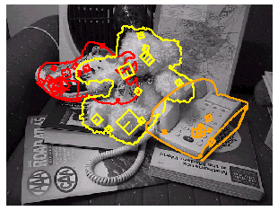
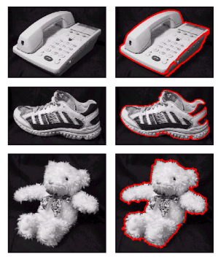
Object recognition (David Lowe)

Slide 38
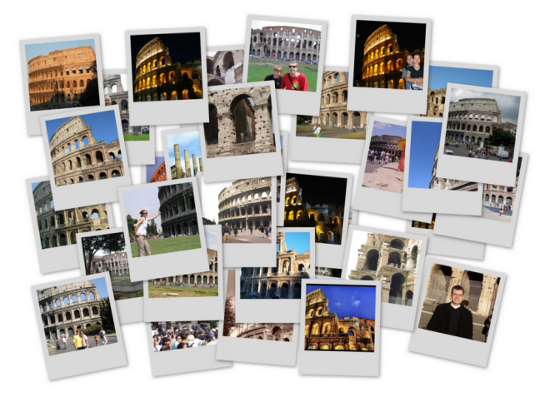
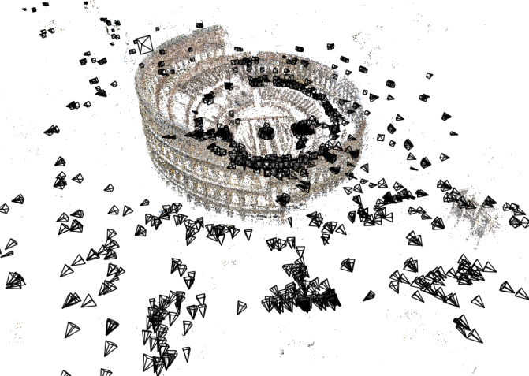
3D Reconstruction
Internet Photos (“Colosseum”)
Reconstructed 3D cameras and points

Slide 39

Sony Aibo
SIFT usage:
Recognize
charging
station
Communicate
with visual
cards
Teach object
recognition

Slide 40
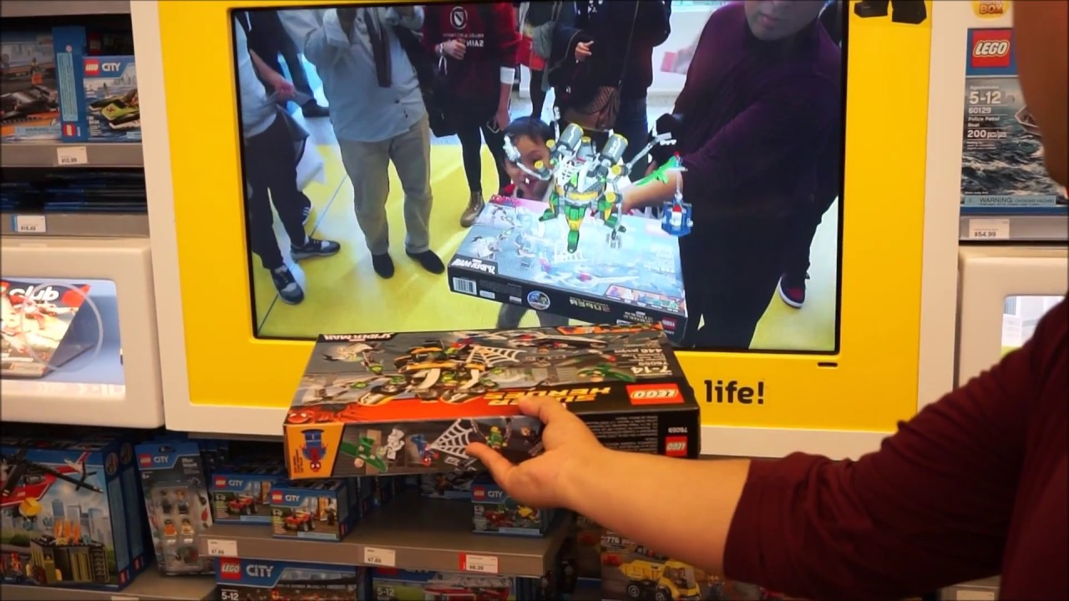
Augmented Reality

Slide 41
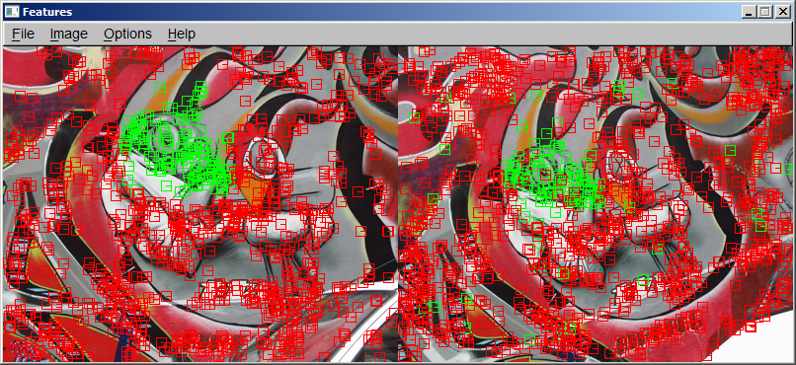
Project 2: Feature detection and matching
http://www.cs.cornell.edu/courses/cs6670/2009fa/projects/p1/project1.html
Demo

Slide 42
Questions?

